Slide 1
BITS Pilani
Dr.Aruna Malapati
Asst Professor
Department of CSIS

Slide 2
Boolean retrieval

Slide 3
Today’s Learning objectives
Understand the inverted index construction
Steps involved in Boolean query processing
Birds eye view of inverted index pipeline
Query optimization

Slide 4
Inverted index
We need variable-size postings lists
  On disk, a continuous run of postings is normal and best
  In memory, can use linked lists or variable length arrays
    Some tradeoffs in size/ease of insertion
Posting
Brutus
1
2
4
11
31
45
173
174
Caesar
1
2
4
5
6
16
57
132
Calpurnia
2
31
54
101
Dictionary
Postings List
Sorted by docID

Slide 5
Inverted index
For each term t, we must store a list of all documents that contain t.
  Identify each by a docID, a document serial number
Can we use fixed-size arrays for this?
Brutus
1
2
4
11
31
45
173
174
Caesar
1
2
4
5
6
16
57
132
Calpurnia
2
31
54
101
What happens if the word Caesar is added to document 14?

Slide 6
Posting list implementations
Arrays vs Linked list
Factors that influence the decision
  Is the corpus fixed?
  Can we fit the entire posting list in main memory?
Notes:
Variable size array vs linked list
Fixed size corpus: arrays
Dynamic array : linked list
Can the posting fit into main memory or not in this case you prefer to store using linked list jumping from one location to the other will need lot of seek time.

Slide 7
Query processing: AND
Consider processing the query:
  Brutus AND Caesar
  Locate Brutus in the Dictionary;
    Retrieve its postings.
  Locate Caesar in the Dictionary;
    Retrieve its postings.
  “Merge” the two postings:
2
4
8
16
32
64
128
Brutus
1
2
3
5
8
13
21
34
Caesar

Slide 8
The merge
Walk through the two postings simultaneously, in time linear in the total number of postings entries
2
2
4
4
8
8
16
16
32
64
128
32
64
128
Brutus
2
8
1
Caesar
1
2
2
3
5
5
8
8
13
13
21
21
34
3
34
If list lengths are x and y, merge takes O(x+y) operations.
Crucial: postings sorted by docID.

Slide 9

Intersecting two postings lists
(a “merge” algorithm)

Slide 10
Intersecting two postings lists
(a “merge” algorithm)
P1: pointer to current location in list1
P2: pointer to current location in list2
p1
2
2
4
4
8
8
16
16
32
64
128
32
64
128
Brutus
2
1
Caesar
1
2
2
3
5
5
8
8
13
13
21
21
34
3
34
Answer
p2
p2

Slide 11
Intersecting two postings lists
(a “merge” algorithm)
P1: pointer to current location in list1
P2: pointer to current location in list2
p1
2
2
4
4
8
8
16
16
32
64
128
32
64
128
Brutus
2
1
Caesar
1
2
2
3
5
5
8
8
13
13
21
21
34
3
34
Answer
p2

Slide 12
Intersecting two postings lists
(a “merge” algorithm)
P1: pointer to current location in list1
P2: pointer to current location in list2
p1
2
2
4
4
8
8
16
16
32
64
128
32
64
128
Brutus
2
1
Caesar
1
2
2
3
5
5
8
8
13
13
21
21
34
3
34
Answer
p2

Slide 13
Intersecting two postings lists
(a “merge” algorithm)
P1: pointer to current location in list1
P2: pointer to current location in list2
p1
2
2
4
4
8
8
16
16
32
64
128
32
64
128
Brutus
2
1
Caesar
1
2
2
3
5
5
8
8
13
13
21
21
34
3
34
Answer
p2

Slide 14
Intersecting two postings lists
(a “merge” algorithm)
P1: pointer to current location in list1
P2: pointer to current location in list2
p1
2
2
4
4
8
8
16
16
32
64
128
32
64
128
Brutus
2
8
1
Caesar
1
2
2
3
5
5
8
8
13
13
21
21
34
3
34
Answer
p2
Postings sorted by DocIds.

Slide 15
More query processing
Brutus OR Caesar
NOT Brutus
Brutus AND NOT Caesar
Brutus OR NOT Caesar

Slide 16
More query processing
Brutus OR Caesar
2
2
4
4
8
8
16
16
32
64
128
32
64
128
Brutus
1
Caesar
1
2
2
3
5
5
8
8
13
13
21
21
34
3
34
1
2
3
4
5
8
13
16
32
21
34
64
128

Slide 17
More query processing
NOT Brutus
2
2
4
4
8
8
16
16
32
64
128
32
64
128
Brutus
1
3
5
6
7
9
…

Slide 18





Inverted index construction
Documents to
be indexed
Friends, Romans, countrymen.
Tokenizer
Token stream
Friends
Romans
Countrymen
Linguistic modules
DE pluralization
Case folding
friend
roman
countryman
Modified tokens/
Stream of normalized
tokens
Indexer
friend
2
4
roman
1
2
Inverted index
13
16
countryman

Slide 19

Indexer steps: Token sequence
Sequence of (Modified token, Document ID) pairs.
Doc 1
Doc 2
I did enact Julius
Caesar I was killed
i' the Capitol;
Brutus killed me.
So let it be with
Caesar. The noble
Brutus hath told you
Caesar was ambitious

Slide 20

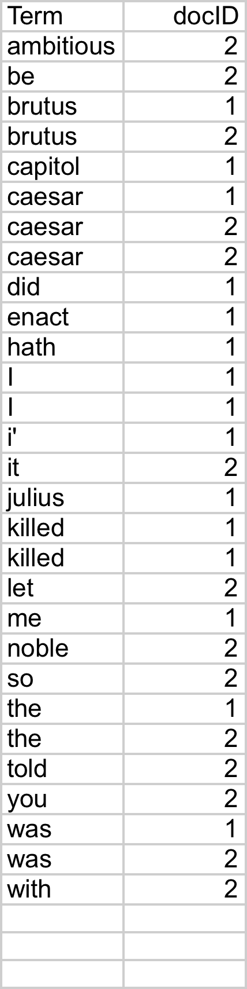
Indexer steps: Sort
Sort by terms
  And then docID
Core indexing step

Slide 21

Indexer steps: Dictionary & Postings
Multiple term entries in a single document are merged.
Split into Dictionary and Postings
Doc. frequency information is added.
Why frequency?
Will discuss later.

Slide 22
Where do we pay in storage?
Lists of docIDs
Terms and counts
Pointers

Slide 23
Query Optimization
Consider a query that is an and of t terms.
For each t terms get the postings list, then AND them together.
Brutus
1
2
4
11
31
45
173
174
Caesar
1
2
4
5
6
16
57
132
Calpurnia
2
31
54
101
QUERY: Brutus AND Caesar AND Calpurnia
Brutus AND (Caesar AND Calpurnia)
(Brutus AND Caesar) AND Calpurnia
(Brutus AND Calpurnia) AND Caesar

Slide 24
Query Optimization
Process in the order of increasing document frequency.
  Intersect the two smallest postings list
  All intermediate results will be no bigger than the smallest postings list, so we are likely to minimize the work.
Brutus
1
2
4
11
31
45
173
174
Caesar
1
2
4
5
6
16
57
132
Calpurnia
2
31
54
101
QUERY: Brutus AND Caesar AND Calpurnia
This is why the doc
freq is stored
Execute the query as (Caesar AND Brutus) AND Calpurnia

Slide 25
More general optimization
e.g (Brutus OR Ceaser) AND (Calpurnia)
Get frequencies for all terms
Estimate the size of each OR by the sum of its’s frequencies (conservative estimate)
Process in increasing order of OR sizes

Slide 26
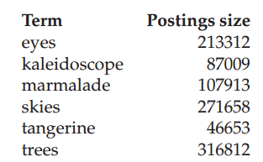
Example
Recommend a query processing order for the following
(tangerine OR trees) AND (marmalade OR skies) AND (kaleidoscope OR eyes)
given the following postings list sizes:

Slide 27
Boolean Retrieval model
The Boolean Retrieval model can answer any query that is a Boolean expression.
  Boolean Queries are queries using AND,OR and NOT to join query terms.
  Views each document as a set of terms.
  Is precise: document matches condition or not.
Primary commercial retrieval tools for 3 decades.
Many professional searchers (e.g., lawyers ) still like Boolean queries:
  You know exactly what you’re getting.
Notes:
Email search
Desktop search
Domain Specific search / Vertical search (righthealth.com)
Medline / PubMed (biology and medicine related papers)

Slide 28
Example of a Boolean Retrieval Model
Commercially successful Boolean retrieval : WEST LAW
www.westlaw.com/
Largest commercial legal search service in terms of number of paying subscribers.
Over half a million subscribers performing millions of searches a day over tens of terabytes of text data.
The service was started in 1975.
Boolean search (called ‘Terms and connectors’ by Westlaw) still the default, and used by large percent of users..

Slide 29
Westlaw Example Queries
Information need: Information on the legal theories involved in preventing the disclosure of trade secrets by employees formerly employed by a competing company
  “trade secret” /s disclos! /s prevent /s employe!
Information need: Requirements for disabled people to be able to access a workplace
  disab! /p access! /s work-site work-place
  (employment /3 place)
Information need:Cases about a host’s responsibility for drunk guests
  host! /p (responsib! liab!) /p (intoxicat! drunk!) /pguest
Notes:
Enterprise search
Space is disjunction not a conjunction by default

Slide 30
Westlaw Example Queries (2)
/s = within same sentence
/p = within same paragraph
/n= within n words
Space is disjunction, not conjunction (This was the default in search pre-Google.)
Long precise queries that use proximity operators.
! is a trailing wildcard query
Notes:
Average length of the query was 10 words long

Slide 31
Limitations of Boolean Retrieval Model
Not tolerant to spelling mistakes
Phrase search(“Stanford University”) and proximity search (Gates /s Microsoft) requires the index to be augmented.
More weight should be given to documents containing higher number of instances of terms?
No ranking of returned results.

Slide 32
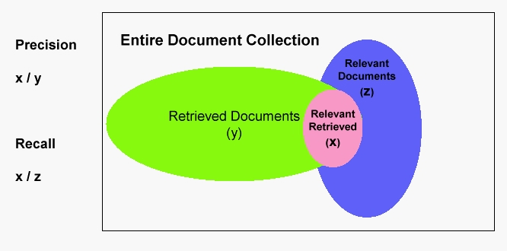
How to evaluate performance of an IR System ?
Precision: Fraction of documents that are relevant to user’s information.
Recall: Fraction of relevant documents in collection that are retrieved.
How can we get 100% recall?
How can we get 100% Precision?
Notes:
Precision: Among all the returned results from the search engine what % are relevant?

Slide 33
Summary
In an IR system a Term incidence matrix is built apriori and queries are answered using Boolean Retrieval Model.
The problem with Term incidence matrix is that it is sparse and hence the inverted index is built.

Slide 34
Summary
The Boolean retrieval model can answer any query that is a Boolean expression.
  Boolean queries are queries that use AND , OR and NOT to join query terms.
  Views each document as a set of terms.
  Is precise: Document matches condition or not.
Primary commercial retrieval tool for 3 decades
Many professional searchers (e.g., lawyers) still like Boolean queries
  You know exactly what you are getting.
When are Boolean queries the best way of searching?
Depends on: information need, searcher, document
collection, . . .

Slide 35
References and suggested readings
http://nlp.stanford.edu/IR-book/pdf/01bool.pdf

